Slide 1



Slide 2
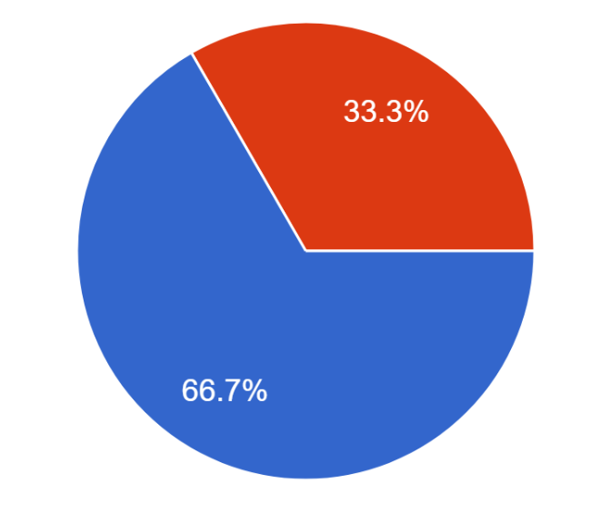
We asked people if an outside expert or extra knowledge would make them more likely to buy from EcoLatté. 66.7% said yes, and 33.3% said no.

Slide 3
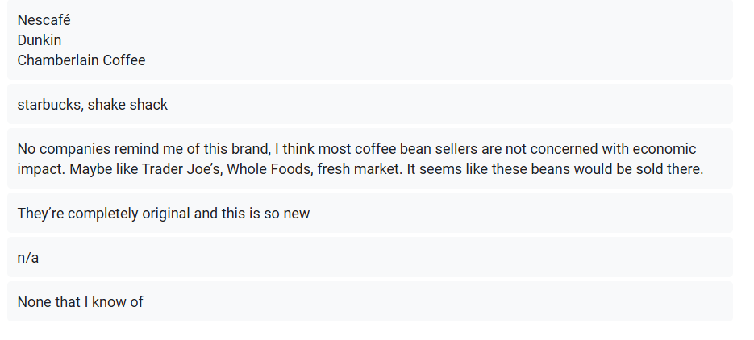
We also asked people who or what our company reminds them of? Most people couldn’t think of any companies that are comparable to us, and others listed popular coffee companies.

